Slide 1
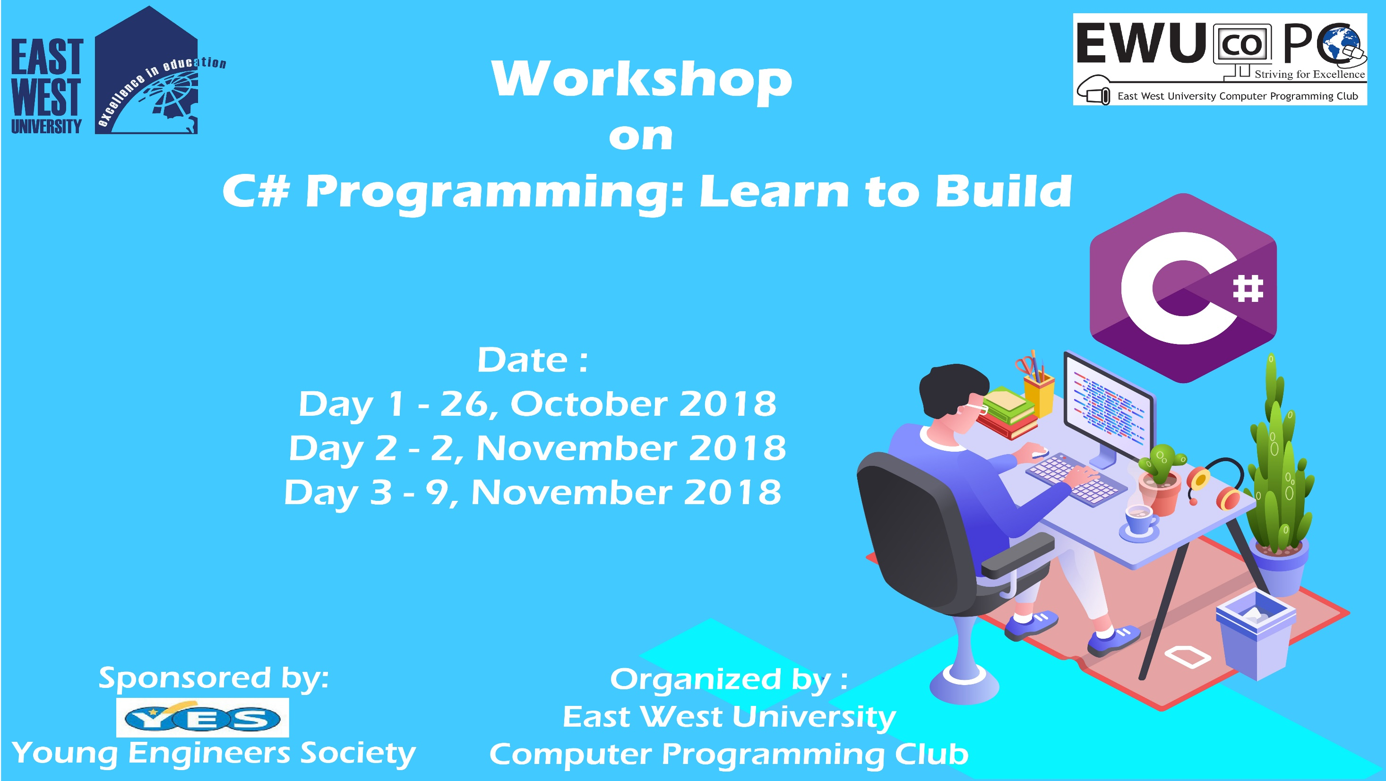

Slide 2
C# Day 1 Lecture1: Basic

Slide 3
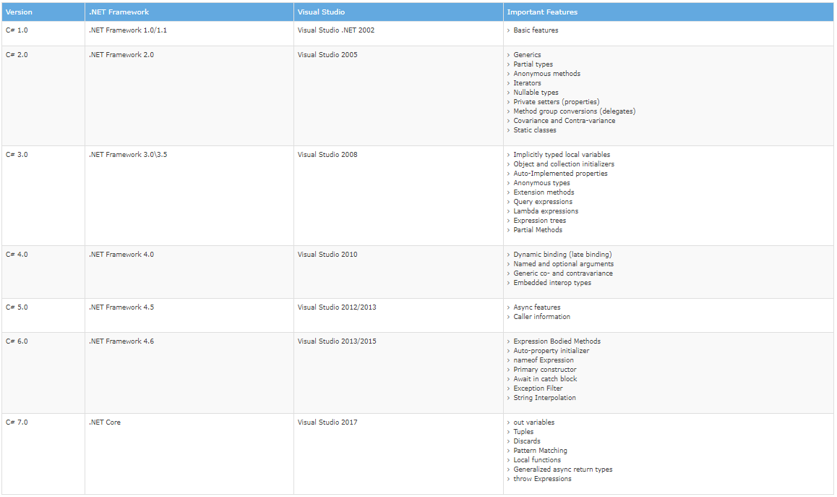

Slide 4
Environment
Tools required:
The .NET Framework is a platform for building, deploying, and running different types of Web and Desktop based Applications & Web Services.
Common Language Runtime (CLR): The .NET Framework contains a run-time environment known as CLR which runs the codes. It provides services to make the development process easy.
Framework Class Library(FCL): It is a library of classes, value types, interfaces that provide access to system functionality.
An IDE (Integrated Development Environment) is a tool that helps to write programs using different programming languages.

Slide 5
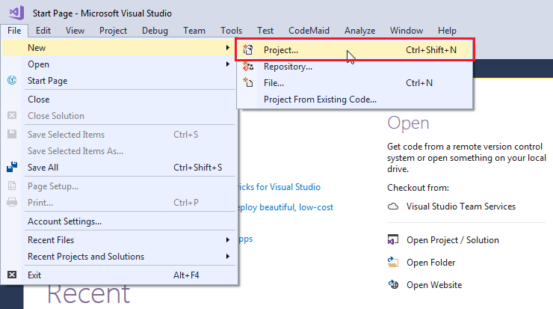

Slide 6
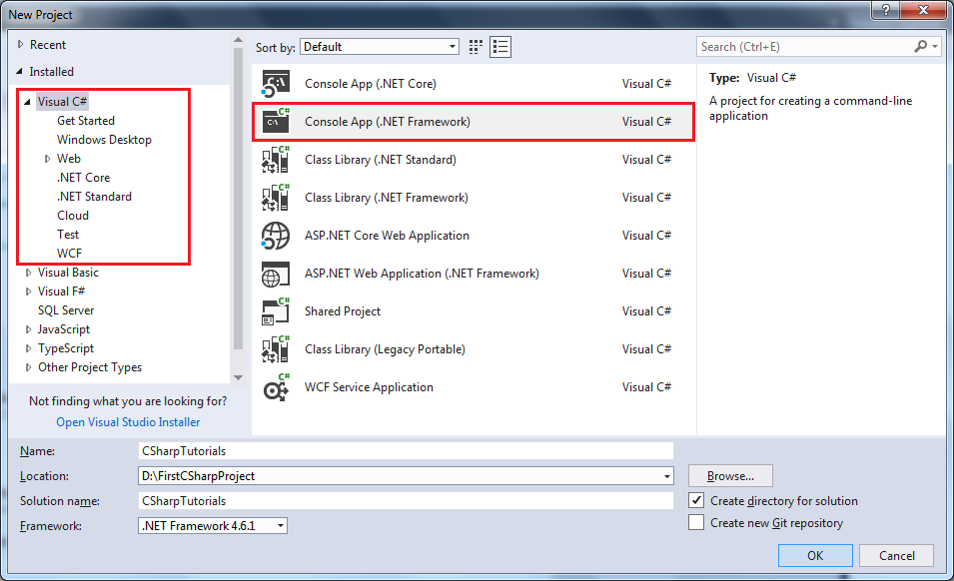

Slide 7
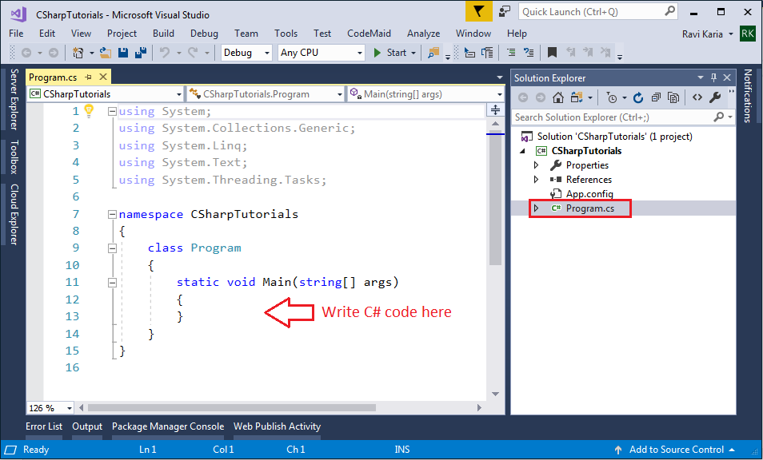

Slide 8
Key Organizational Concepts in C#
C# is developed by Anders Hejlsberg at Microsoft in 2000 as a rival to Java.
Programs
Namespaces
Types
member

Slide 9
Topic
C# Environment
Basic Syntax
Data Types
Type Casting
Variables
Operators
Decision Making
Loops
Methods
Arrays
String
Class
Static Keyword

Slide 10
Features of C#
simple, modern, object-oriented
type-safe programming language
component-oriented programming
garbage collection
exception handling

Slide 11
Basic Syntax: Write()
using System;
namespace Basic_syntax
{
class Program
{
static void Main(string[] args)
{
Console.Write("I’m Jannat Binta Alam. And you?");
}
}
}

Slide 12
Basic Syntax: Read()
using System;
namespace Basic_syntax
{
class Program
{
static void Main(string[] args)
{
Console.Write("I’m Jannat Binta Alam. And you?");
Console.Read();
}
}
}

Slide 13
Basic Syntax: Clear()
using System;
namespace Basic_syntax
{
class Program
{
static void Main(string[] args)
{
Console.Write("I’m Jannat Binta Alam. And you?");
Console.Read();
Console.Clear();
}
}
}

Slide 14
Comment
Single Line Comment
// comment
Multiline Comment
/* first line
last line */

Slide 15
Your First Program
Program Name: Hello Universe
Author Name: Jannat Binta Alam
Task: A Program to Print “Hello Universe”
Date: 26th October, 2018: 8.30AM
Or 26.10.2018:8.30AM

Slide 16
Problem Set
Write a program to print “Hello Universe! –Your Name” in console.

Slide 17
Hello Universe!
using System;
class Hello
{
static void Main()
{
Console.WriteLine("Hello Universe!");
Console.ReadKey();
}
}

Slide 18
Hello Universe!
class Hello
{
static void Main()
{
System.Console.WriteLine("Hello Universe!");
System.Console.ReadKey();
}
}

Slide 19
Basic Syntax: BackgroundColor
using System;
namespace Basic_syntax
{
class Program
{
static void Main(string[] args)
{
Console.BackgroundColor = ConsoleColor.DarkBlue;
}
}
}

Slide 20
Basic Syntax: Read()
using System;
namespace Basic_syntax
{
class Program
{
static void Main(string[] args)
{
Console.BackgroundColor = ConsoleColor.DarkBlue;
Console.Read();
}
}
}

Slide 21
Basic Syntax: WriteLine()
using System;
namespace Basic_syntax
{
class Program
{
static void Main(string[] args)
{
Console.BackgroundColor = ConsoleColor.DarkBlue;
Console.WriteLine("C#: Learn to Build!");
Console.Read();
}
}
}

Slide 22
Basic Syntax: BackgroundColor
using System;
namespace Basic_syntax
{
class Program
{
static void Main(string[] args)
{
Console.BackgroundColor = ConsoleColor.DarkBlue;
Console.Clear();
Console.WriteLine("C#: Learn to Build!");
Console.Read();
}
}
}

Slide 23
Basic Syntax: ForegroundColor
using System;
namespace Basic_syntax
{
class Program
{
static void Main(string[] args)
{
Console.ForegroundColor = ConsoleColor.Green;
Console.WriteLine("C#: Learn to Build!");
Console.ReadKey();
}
}
}

Slide 24
Basic Syntax: Beep
using System;
namespace Basic_syntax
{
class Program
{
static void Main(string[] args)
{
Console.ForegroundColor = ConsoleColor.Green;
Console.WriteLine("C#: Learn to Build!");
Console.Beep(2100,1000); //(int frequency, int millisecond)
Console.ReadKey();
}
}
}

Slide 25
Basic Syntax: Color Variable
using System;
namespace Basic_syntax
{
class Program
{
static void Main(string[] args)
{
ConsoleColor col = Console.BackgroundColor;
Console.Write(col);
}
}
}

Slide 26
Basic Syntax: Color Variable
using System;
namespace Basic_syntax
{
class Program
{
static void Main(string[] args)
{
Console.BackgroundColor = ConsoleColor.DarkBlue;
ConsoleColor col = Console.BackgroundColor;
Console.Write(col);
}
}
}

Slide 27
Basic Syntax: Color Variable
using System;
namespace Basic_syntax
{
class Program
{
static void Main(string[] args)
{
ConsoleColor col = Console.ForegroundColor;
Console.Write(col);
}
}
}

Slide 28
Basic Syntax: Color Variable
using System;
namespace Basic_syntax
{
class Program
{
static void Main(string[] args)
{
Console.ForegroundColor = ConsoleColor.Green;
ConsoleColor col = Console.ForegroundColor;
Console.Write(col);
}
}
}

Slide 29
Basic Syntax: Color Variable
using System;
namespace Basic_syntax
{
class Program
{
static void Main(string[] args)
{
ConsoleColor col = Console.BackgroundColor;
ConsoleColor col1 = Console.ForegroundColor;
Console.Write(col);
Console.Write(col1);
Console.Read();
}
}
}

Slide 30
Basic Syntax: CursorSize
using System;
namespace Basic_syntax
{
class Program
{
static void Main(string[] args)
{
Console.CursorSize = 100; //range=1-100
Console.ForegroundColor = ConsoleColor.DarkRed;
Console.Write(("C#: Learn to Build!“);
}
}
}

Slide 31
Basic Syntax: SetWindowSize()
using System;
namespace Basic_syntax
{
class Program
{
static void Main(string[] args)
{
Console.Write(("C#: Learn to Build!“);
Console.SetWindowSize(200, 50); //(width, height); max h=50.
}
}
}

Slide 32
This slide is provided as a course material in the workshop named “Workshop on C# Programming: Learn to Build”.
Organized by-
East West University Computer Programming Club (EWUCoPC)
Prepared by- Jannat Binta Alam
Campus Ambassador
Young Engineers Society (YES)
E-mail: jannat.cse.ewu@gmail.com

